Slide 1
W
W.Brain
/ by Wayanjo
PRIVATE AI EXECUTION LAYER FOR REGULATED INDUSTRIES
We build the data + execution layer AI needs to actually work inside a business
Arthur Kerimov · Maxim Vasyliev · Mikhail Tugarev · team@wayanjo.com
Dubai, UAE

Slide 2
THE PROBLEM
Every CEO wants AI
Almost none know how to rebuild around it
ChatGPT works in a tab. Copilot works on one document. But the moment you ask AI to run a real process across messy data, real workflows, regulated environments it breaks. Businesses have models. They don't have a way to operationalize them.

Slide 3
THE GAP
Two things are missing between AI and the business
LAYER 01
LAYER 02
Data collection
AI execution
A way to continuously capture how the company actually runs — documents, decisions, workflows, recorded screens, system events — into a private, structured memory.
→
A controlled layer that lets agents act on that memory — with permissions, audit trail, human approval, and integrations into the company's real systems.
TODAY: SCATTERED ACROSS 90+ TOOLS
TODAY: DOESN'T EXIST FOR MOST BUSINESSES
The market has 1,000 chatbots. It has zero standard way to give a company structured memory and an execution layer it can trust. That is the entire opportunity.

Slide 4
Why now?
Every regulated industry will run on a private execution layer
Generic AI (ChatGPT, Copilot, Claude) will own the consumer and the open knowledge worker. The serious money defense, aerospace, government, healthcare, finance, energy will run on private, in-cloud execution layers built around each industry
We are building one of those

Slide 5
WHAT W.BRAIN IS
First wedge: procurement and aerospace document workflows
Recordings
Documents
Email
W.Brain
CRM
Drive
We map a company's real workflows. We build the data collection layer that captures them. We build the execution layer that acts on them. It runs entirely inside your perimeter not ours, not OpenAI's, not Microsoft's.
Tenders
Workflows
100% in your cloud
Built per industry
Audit-trailed
Model-agnostic

Slide 6
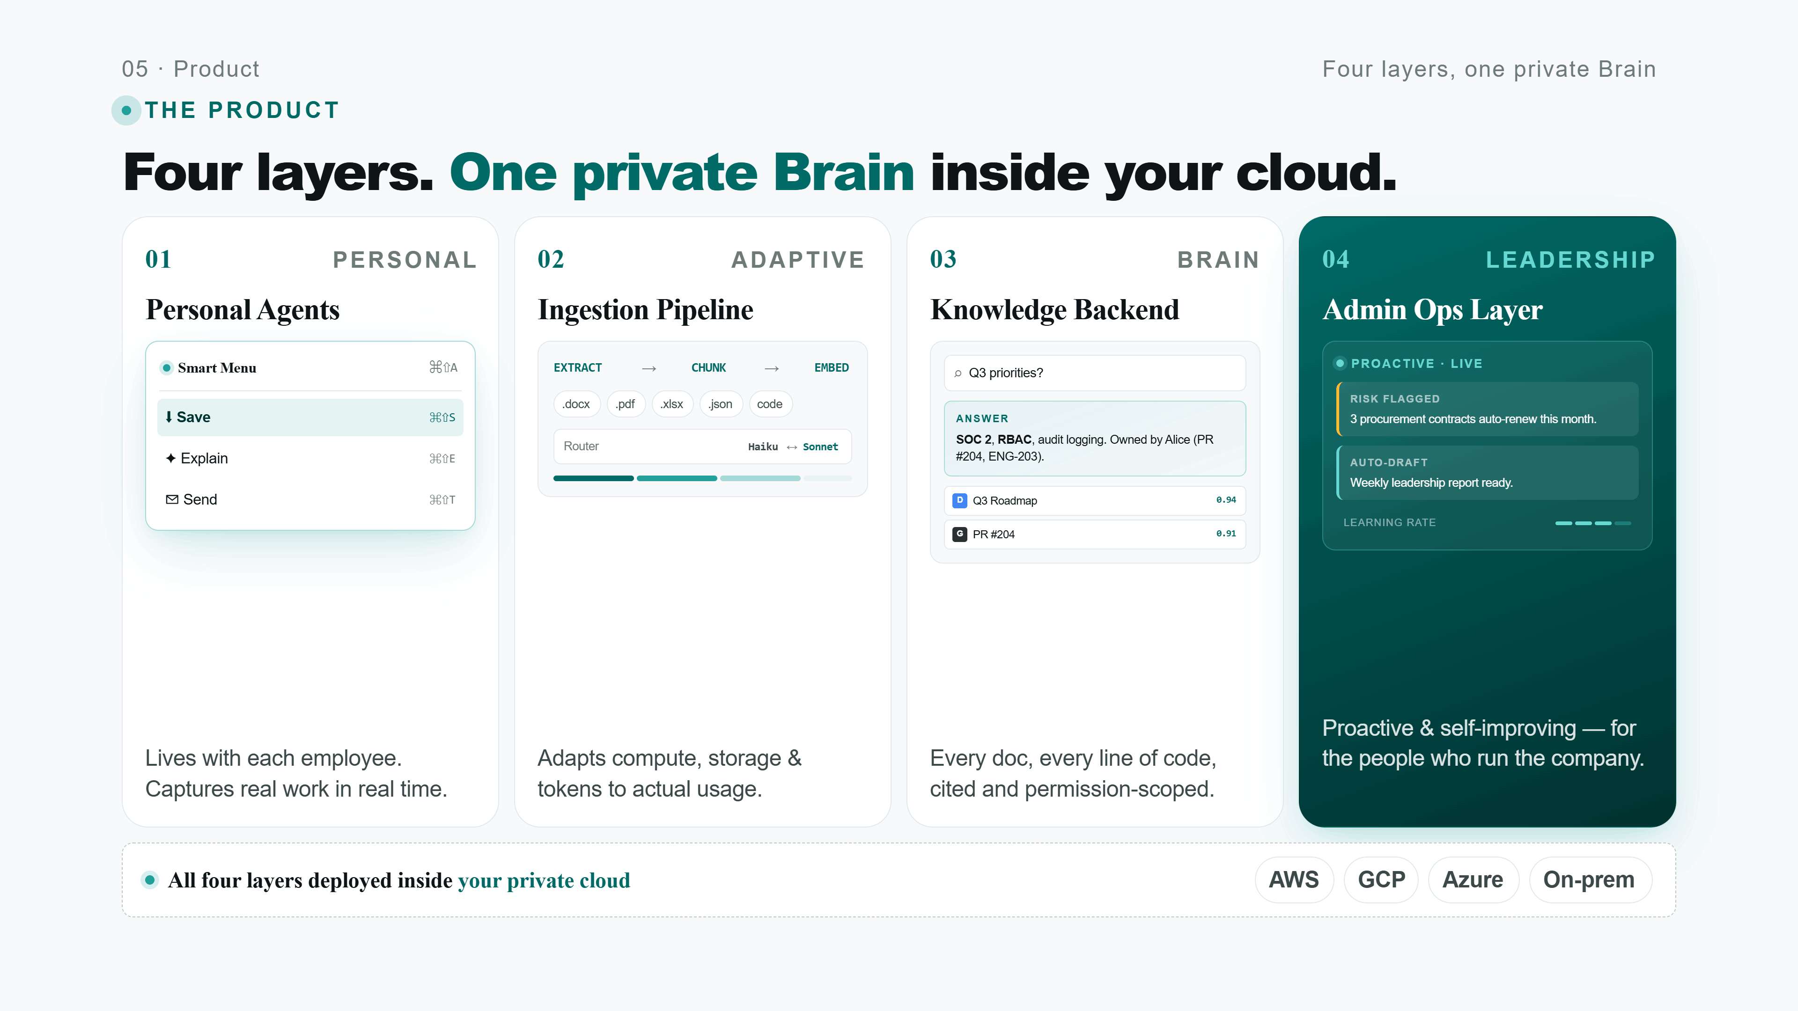

Slide 7
TRACTION
We've already shipped it to the hardest buyers
REVENUE EARNED · 2025-26
CUSTOMER 01 · AEROSPACE
Aerospace government contractor
$90K+
Private AI knowledge base. Engineers query internal technical documents, regulations, and design specs without anything leaving the perimeter.
~$70K
Across two paid pilots, both shipped to production. Two of the hardest buyers in the world: an aerospace government contractor and a national university procurement department.
CUSTOMER 02 · PROCUREMENT
Major Russian university procurement
Tender & supplier analysis system. Parses messy supplier docs, extracts requirements, prepares decision-ready comparisons.
2
100%
0
~$20K
live deployments
delivered & in use
external funding

Slide 8
MARKET
The generic AI market is gone…
The private vertical AI market is open
GENERIC AI
VERTICAL SAAS
W.BRAIN
TAM · ENTERPRISE AI
$300B BY 2030
ChatGPT, Copilot
Notion, Slack
private layer
Runs in your cloud
No
No
Yes
SAM
VERTICAL AI $42B
Built per industry
No
No
Yes
SOM
Captures workflows
No
Partial
Yes
$3-5B
OUR WEDGE
Executes actions
Chat only
Manual
End-to-end
Defense / gov fit
Limited
Limited
Made for it
The space the giants can't enter is exactly where the budget lives.

Slide 9
GO-TO-MARKET
Land in one regulated industry. Productize Move to the next
NOW · 2026
2026 H2
2027
Procurement & aerospace
Productize the template
Expand industries
Healthcare, energy, defense ,same playbook. SI partners (Deloitte, Accenture, regionals) resell the platform. We own infrastructure, they own the cycle.
Two paying customers, two production deployments. Use these to harden the platform and earn 3-5 more in the same verticals.
Turn the deployed Brains into a verticalized template. Deploy time drops from weeks to days. Custom builds fund the productization.
→
→
$90K already earned
Target: 10 customers
$3M ARR target

Slide 10
WHAT COULD GO WRONG
Three honest risks
Three honest answers
RISK 01 · BIG TECH
They will for the generic, horizontal case. They will not deploy inside a defense contractor's air-gapped cloud, write industry-specific workflows, or sign a sovereignty clause. That entire segment is structurally off-limits to them. It's exactly where we play.
"OpenAI, Microsoft, or Anthropic ship this themselves."
RISK 02 · CONSULTING TRAP
Each custom build deliberately hardens one reusable piece of the platform capture, structure, execution, audit. Two deployments in, the platform layer already shows up. We are productizing, not just shipping bespoke.
"You'll get stuck as an AI consultancy forever."
RISK 03 · ENTERPRISE SALES
We don't sell to F500 yet. We sell to AI-forward operators inside regulated orgs procurement leads, engineering directors, compliance officers where the cycle is 4-8 weeks and the budget already exists. We move upmarket only after the template is locked.
"Regulated industries take 12 months to close."

Slide 11



THE TEAM
Three co-founders - Friends since school
CO-FOUNDER
CO-FOUNDER
CO-FOUNDER
Arthur Kerimov
Maxim Vasyliev
Mikhail Tugarev
5+ years across AI, IoT, fintech, SaaS. Owns product, UX, sales, and operations. Closed the first two W.Brain contracts
5+ years building high-scale distributed systems across e-commerce, real estate, and aerospace. Owns the execution layer architecture
6+ years on high-scale distributed systems across e-commerce, travel, and aerospace engineering. Owns the data capture & structuring layer
We've known each other since school. We've already shipped two production deployments together without a dollar of outside funding

Slide 12
W
W.Brain
THE ASK
Raise $1.5M
We already sold private AI platforms to procurement and aerospace teams. Now we are turning those deployments into a repeatable platform
ROUND
RUNWAY
TARGET BY A
$1.5M SAFE
18 months
$3M ARR · 12 customers
Arthur Kerimov · team@wayanjo.com · calendly.com/kerimovartur-official
wayanjo.com/ai-company-brain

